Slide 1
NEO4J CYPHER TUTORIAL WITH PYTHON
UPDATE NODE COUNT AFTER DELETION
Tutorial 62

Slide 2
UPDATE NODE COUNT AFTER DELETION USING PYTHON
USE CASE
YOU HAVE 10 SHIRTS NODE,10 TSHIRTS NODE & 10 JEANS NODE
EVERYTIME YOU WILL BE ASKED TO SELECT ONE NODE (THSIRTS,SHIRTS OR JEANS)
AFTER EVERY SELECTION GRAPH DB SHOULD BE UPDATED,AND NEW NODE COUNT WILL BE DISPLAYED

Slide 3
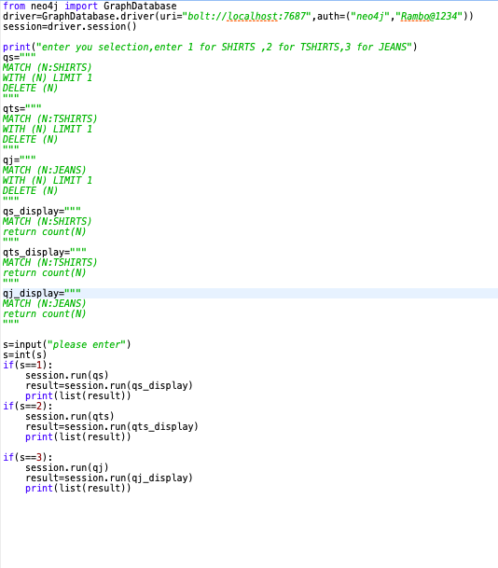
UPDATE NODE COUNT AFTER DELETION USING PYTHON
SAMPLE CODE

